Slide 1

Houston, We Have an Allergy Problem
Predicting Pollen Counts in Texas
May, 2022
Notes:
Hello and welcome I’m delighted to be able to speak to the CDC about Allergy Awareness. This Analysis focuses on just 1 U.S. City, namely Houston Texas where allergies

Slide 2

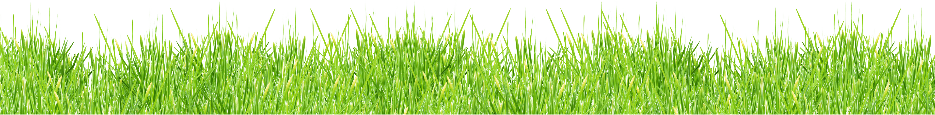
Flat Iron Data Science Graduate www.github.com/nikennedy nrokennedy@gmail.com
Nicholas Ross O’Keefe Kennedy
This Photo by Unknown Author is licensed under CC BY-NC
Notes:
My name is Nicholas Kennedy and I’m a graduate of Flat Iron’s Data Science Bootcamp

Slide 3
Agenda:
1. Introduction & Business Understanding
2. Business Problem
5. Modeling: Classification & Time-Series
3. Data Understanding
4. Initial Analysis
6. Results
7. Species-Specific Diagnostic Tool Proposal
10. References & Appendix
8. Further Considerations
9. Conclusion
Notes:
Today We’re going to introduce and provide context for the pollen allergy research in the U.S. and more specifically Houston Texas. I’ll then take us through our business problem and the data I used for this analysis. I’ll then cover some basic findings followed by the classification and time-series modeling and report the most successful findings. I’ll go on to propose an application that uses species-specific pollen counts to use as a diagnostic tool for allergy sufferers along with other future considerations before ending with this report’s conclusions.

Slide 4
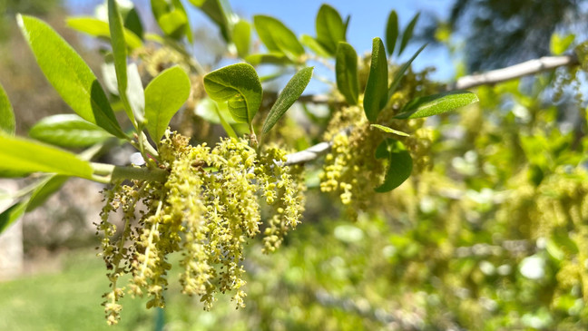
Introduction: Allergies & Public Health After Covid-19
Heightened Public Awareness of Allergies
2. Seasonal Strain on Healthcare Providers
Notes:
In my family my siblings and I like to joke about how our dad, who has always suffered from allergies, would always claim that any illness we or he had was probably allergies. This blindspot of his became a bit more serious when, at 72, he contracted the Covid-19 virus. Believing, as he does, that it was allergies, he didn’t even get tested until he had mostly recovered. Luckly his symptoms were mild, but the confusion and fear about Covid -19 and Allergy symptoms has affected many. Shedding light on the timing and causes of Allergies is now a much more important topic, not only to empower individuals, but to also prepare healthcare facilities for the upswing of visits and covid-tests that invariably increase with the pollen counts.

Slide 5

Allergies: A Business Problem
Preparing Medical Providers & the General Public
for Allergy Season Through Public Health Initiatives
Notes:
While Seasonal Allergies happen with regularity across the country, the individual location and timing of pollen blooms varies based on seasonal growth cues across time zones and climates such as light exposure and temperature. Aside from proximity-dependent plant growth cycles, other environmental features may play a role. Furthermore pollen can travel hundreds of miles so more distant weather conditions should also influence counts to a degree. Using information like wind speed, temperature, precipitation both locally in Houston and over 200 miles away, this report hopes to investigate the role that daily climate conditions play in pollen counts. With the threat of a Covid Resurgence always looming, The hope is that the CDC can use pollen counts to prepare medical care providers before they get overwhelmed as well as educate individual allergy suffers as to the timing and eventually the source of their allergies.

Slide 6

The Data: Pollen
All Pollen Data From Houston Health Dept.
Monthly Tallies of Species-Specific Pollen Counts per m³
Business Days from January 2013 to April 2022
This Photo by Unknown Author is licensed under CC BY-NC
Notes:
The Pollen Counts come from the Houston Health Department’s website. Individual monthly tallies of species-specific tree, grass and weed pollen specimens in terms of counts per cubic meter. The collection required skilled technicians so readings are not available for weekends and holidays and these missing valies were imputed. Data consisted of daily counts from 2013 to the present. Individual spreadsheets for the 100+ months were combined and compared to climate data

Slide 7

The Data: Climate
Daily Climate Data from NOAA
2 Testing Centers in Houston, TX, 1 from Shreveport, LA
Average Daily Temp (˚F),
Average Wind Speed (mph),
Precipitation (in.)
This Photo by Unknown Author is licensed under CC BY-NC
This Photo by Unknown Author is licensed under CC BY
Notes:
The climate data comes from National Oceanic and Atmospheric Administration's (NOAA) National Center for Environmental Information (NCEI). From data collection sites in Houston (2 of them) and Shreveport. Shreveport is 200+ miles from Houston beyond a highly vegetated area and thus was considered to be a location that could potentiatlly produce pollen that winds up in Houston.

Slide 8
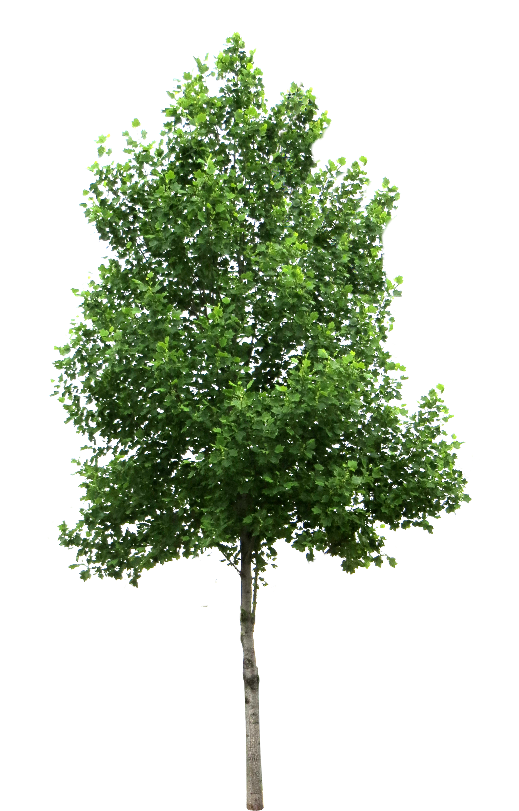
Pollen Counts & Allergies
TREE POLLEN:
90-1499 /m³: Heavy
1500+ /m³: Extremely Heavy
GRASS POLLEN:
20-199/m³: Heavy
200+ /m³: Extremely Heavy
WEED POLLEN:
50-499 /m³ : Heavy
500+ /m³: Extremely Heavy
This Photo by Unknown Author is licensed under CC BY-NC
This Photo by Unknown Author is licensed under CC BY-NC
Notes:
Different classes of pollen have different thresholds for severity. For example grass pollen is considered extremely heavy at counts greater than 200 per cubic meter, whereas tree pollen isn’t considered extremely heavy until levels greater than 1500 grains per m3

Slide 9
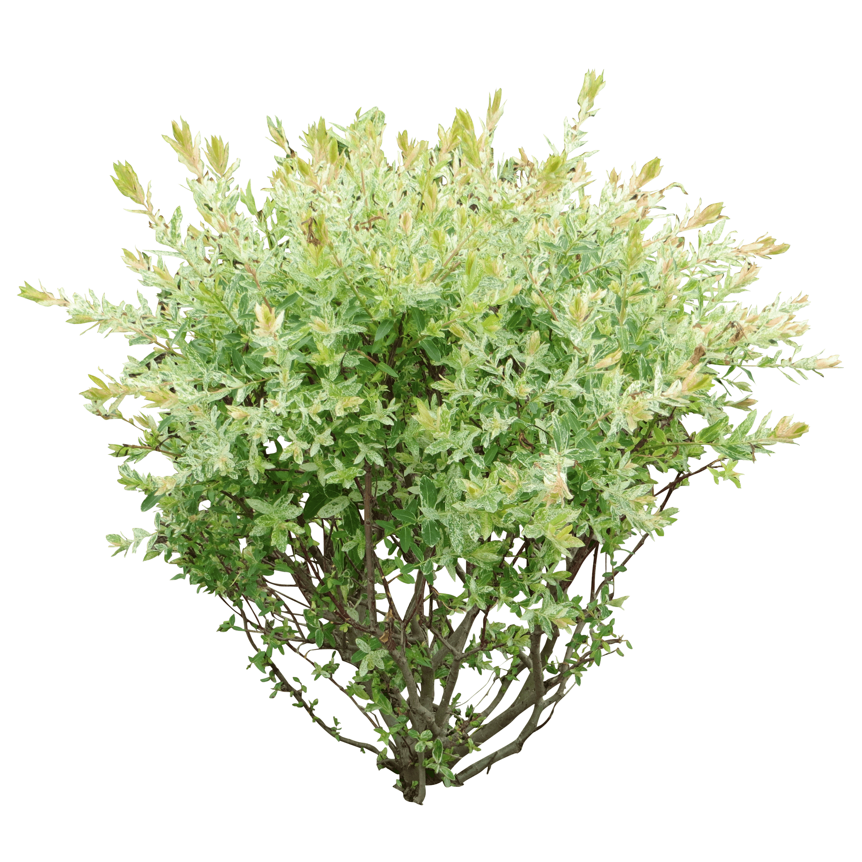
Weighted Pollen Counts
Weighted using Different Severities of Tree, Grass and Weed
“high” pollen set at 100+ particles per m³ per HHD
~50% of days ‘high’ pollen for Houston, TX
This Photo by Unknown Author is licensed under CC BY-NC
This Photo by Unknown Author is licensed under CC BY-NC
Notes:
Because of the varying strength, Weed , Grass and Tree pollens were weighted proportionally to their heaviness thresholds and combined into a weighted pollen feature. 100 parts per cubic meter is considered Heavy for all 3 types and was chosen that the cutoff for what this report considers high levels of pollen. Accoring to this criterion, just over 50% of the days of the year in Houston are considered heavy or “high” pollen days.

Slide 10
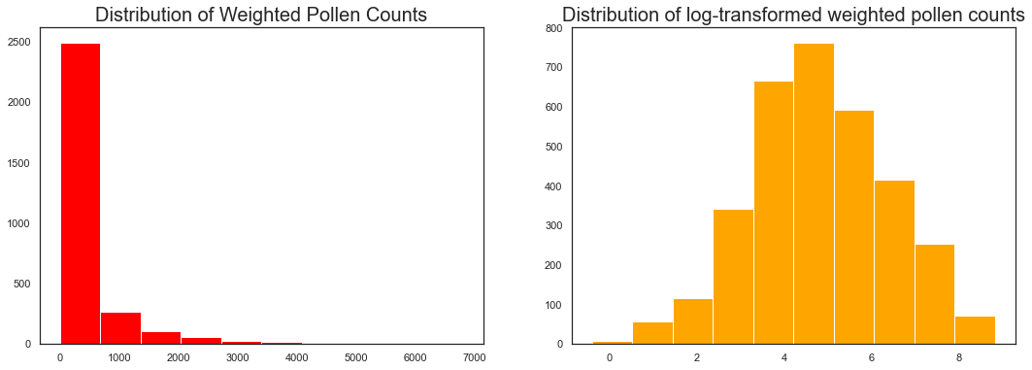
Exploratory Findings
Many Days had pollen counts of zero especially in summertime
Max Pollen Count of over 9,000 per m³ occurred in March, 2019
Pollen’s Logarithmic Distribution
Notes:
Many days throughout the year had pollen counts of 0 for many of the species. Pollen production itself grows on an exponential scale like many natural processes. Analyzing the log transformed pollen counts not only makes conceptual sense, but also renders the data more normally distributed and thus more interpretable and suitable for modeling. Here on the right you can see that after the log-transformation, the pollen counts resemble the bell-curve statisticians so adore

Slide 11
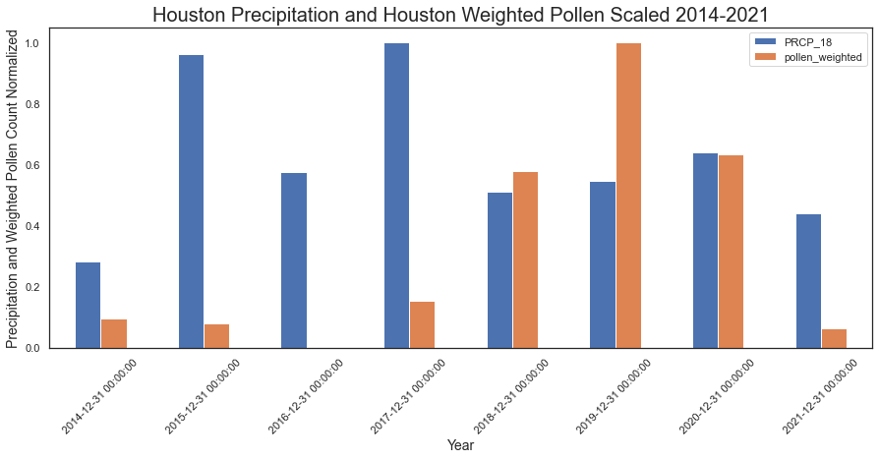
Exploratory Findings
* Also True for Shreveport,
& other variables (see Appendix)
No Clear Correlation Between Local Precipitation* and Pollen Counts for Current or Prior Year
Notes:
Looking at the yearly tallies for the variables in question, in this slide Precipitation, no clear relationship between current year or following year’s pollen counts was immediately apparent.

Slide 12
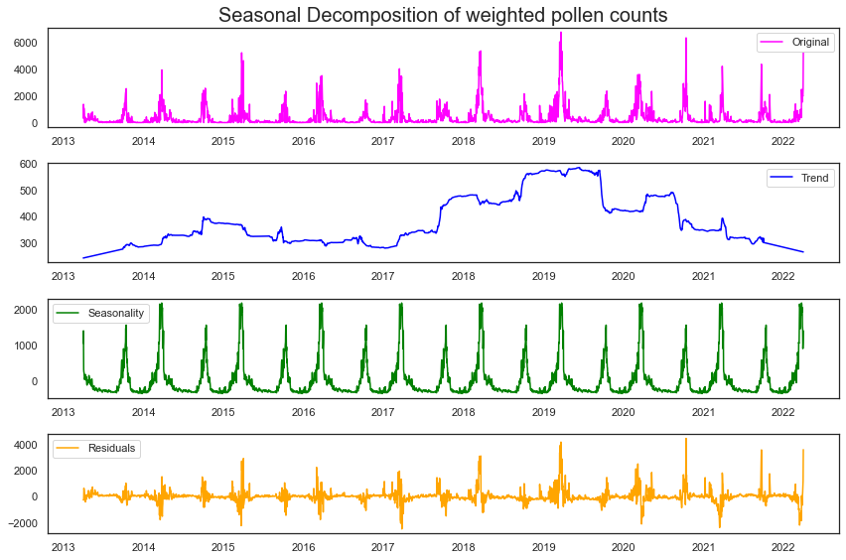
Classification Modeling: The Seasonality Problem
Notes:
Pollen Counts Are Highly Seasonal, thus 2 methods were used to remove the seasonal component of the data and ensure stationarity: Differencing and Seasonal Decomposition. Here the top plot, the raw weighted pollen counts, which is decomposed below into its trend element, seasonal elements and the residuals. This seasonal decomposition was applied to all climate variables in an attempt to remove the influence of their seasonality

Slide 13
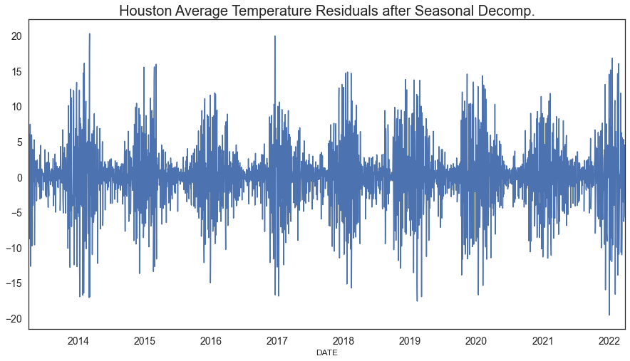
Classification Modeling
Decision Tree: Local Temp = Most Important Feature
Random Forest Classifier Achieved 60% Accuracy
Seasonality persists after decomposition?
Notes:
For classification of both differenced and decomposed data, a Decision tree –type model was preferred due to the high levels of multicollinearity. Random Forest Classifiers Ended up outperforming all others for both sets of processed data achieving 60% accuracy when predicting high pollen days. This would mean that daily climate statistics do in fact influence airborne pollen levels outside of their seasonal components that like pollen have cyclic regularity. While the typical measure for stationarity, a dickey fuller test shows that all the decomposed data is in fact starionary and theoretically devoid of seasonality, the visual pattern in the residuals of the variables like temperature still appear to the eye to have seasonal dependence.

Slide 14
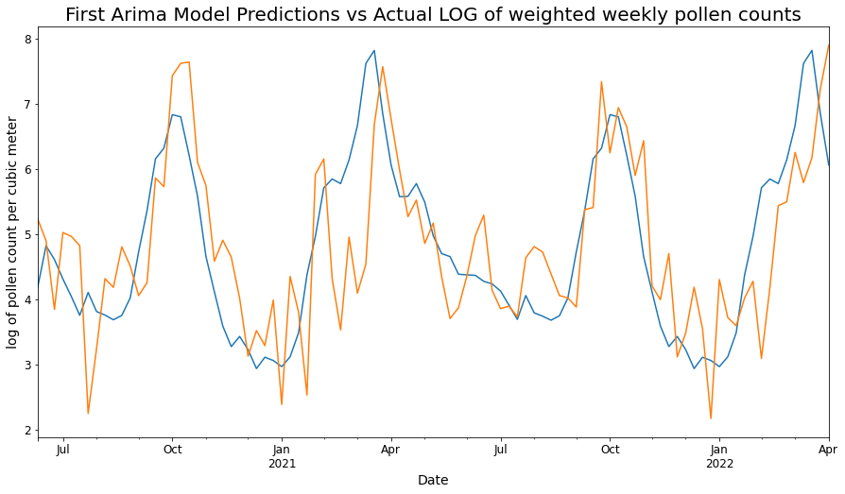
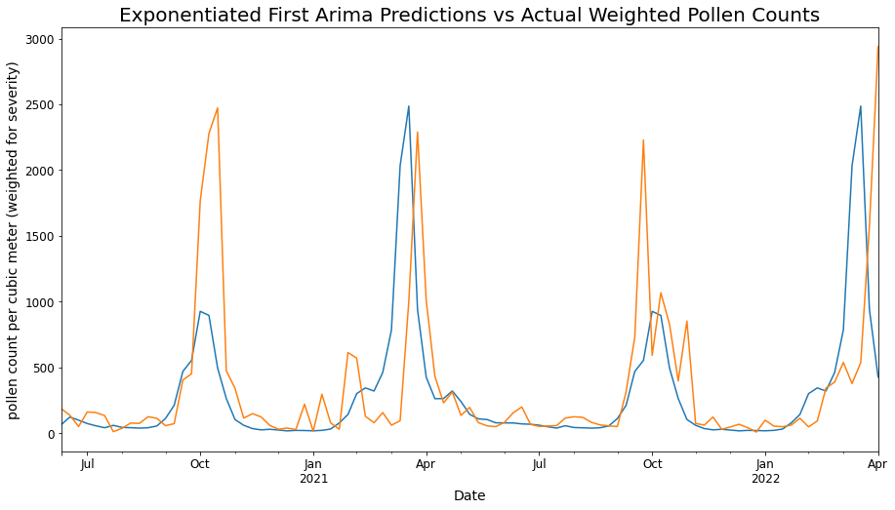
Time-Series Modeling
Notes:
*Time series modeling was performed and evaluated in terms of AIC and RMSE. Sarima models were used because of the seasonality which required looking at weekly averages. Sarima models were more successful at modeling log-transformed data, but Shifted data out performed SARIMA models in terms of RMSE and model

Slide 15
Results
Classification:
Best Model was Random Forest 60% Accuracy, 59% Precision
Time Series:
Best Predictor was Prior Year’s Pollen Counts
Off by ~ 425 particles per m³ on average
This Photo by Unknown Author is licensed under CC BY-NC
This Photo by Unknown Author is licensed under CC BY-NC
Notes:
The Random Forest Classifier was the most successful machine learning model at predicting high pollen days with an Accuracy of 60% on decomposed residuals.
Despite some success with Sarima models, the the previous year’s weighted pollen counts predicted the test group’s counts with the least amount of RMSE.

Slide 16
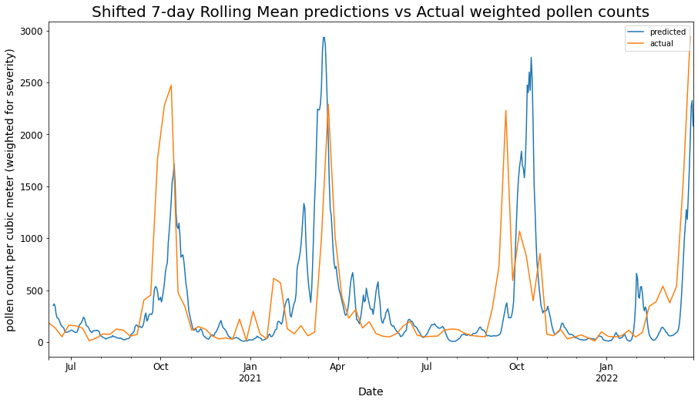
Results: Best Predictions => Last Year’s Data

Slide 17

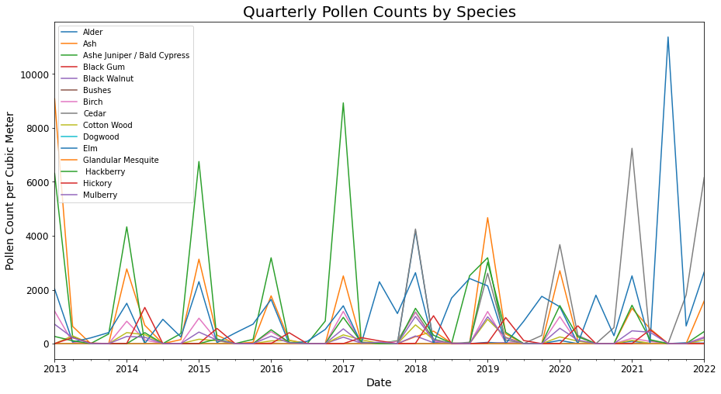
Proposal for Next Steps: Species-Specific Diagnostic Tool
Notes:
While modeling high pollen days in both time series and classification models can predict with some accuracy potentially bad days for allergy sufferers, by working with pharmacies and consumers it would be possible to develop a diagnostic tool to identify potential allergens for people. Getting a professional diagnosis is impractical for many americans due to scarcity of allergists and more importantly costs. By teaming with self-reporting individual allergy sufferers as well as drug stores and pharmacies to collect data on allergy medication purchases throughout the last decade, a odds can be calculated and conclusions can be drawn about which specific plant species(‘) causes allergies. By helping people better understand their allergies this system could empower people to take charge of their allergies in whatever manner they choose.

Slide 18

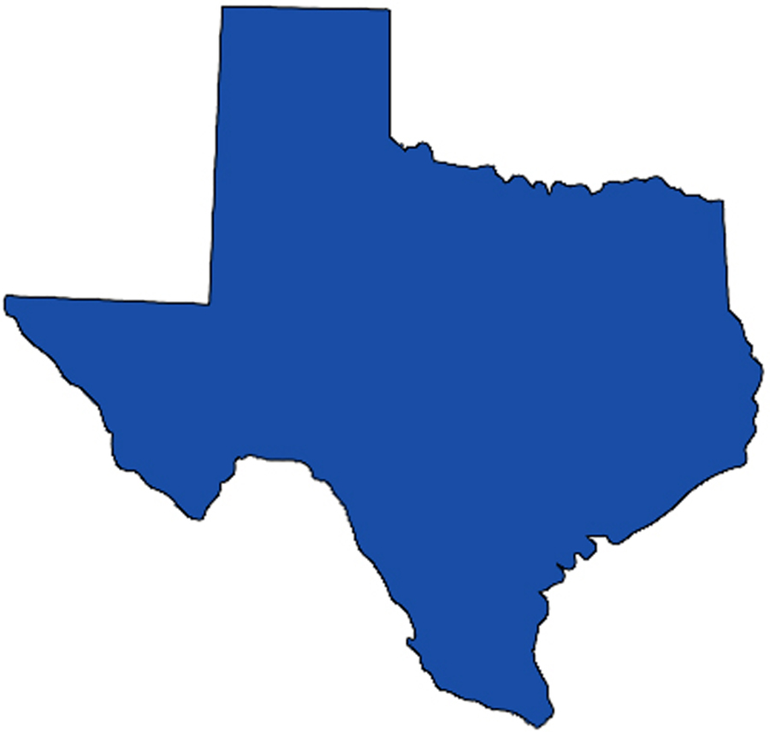
Further Considerations:
Mold Spores
2. More Local and Statewide Data
This Photo by Unknown Author is licensed under CC BY-NC-ND
Notes:
In addition to airborne pollen, mold spores are also a major source of allergies for people. The Houston Health Department also has data for species-specific mold spore counts over the same period. It’s possible that mold is more dependent on current local climate data and total precipitation than pollen is. Adding more climate data from all around Texas and perhaps surrounding states, as well as information like humidity could enhance the models accuracy and shed more light on the local vs state-wide climate conditions on Houston’s airborne allergen levels. PCA to take care of the multicollinearity of these data could be employed such that logistic regression could be employed.

Slide 19
Conclusion
Seasonality is King
The local seasonality of pollen production is the best
predictor of pollen counts.
This Photo by Unknown Author is licensed under CC BY-NC
This Photo by Unknown Author is licensed under CC BY-NC
Notes:
More than anything, the seasonal pattern of pollen counts is predictable with last year’s data forecasting pollen counts with less error than fancier machine-learning based time-series models. Classification based of climate data is not particularly effective and its unclear if seasonality can really even be divorced from these data even with stationarity techniques and metrics. Using Species Specific data and tracking of allergy severity either through medication purchases or personal reporting could be used in an application to help identify peoples’ allergy causes without the hassle of seeing an allergist. While it doesn’t replace a diagnosis, helping people understand the timing and sources of their allergies may very well prevent overwhelimg healthcare resources in the post-Covid world

Slide 20
Thanks! Questions and Comments
Flat Iron Data Science Graduate www.github.com/nikennedy nrokennedy@gmail.com
This Photo by Unknown Author is licensed under CC BY-NC
Notes:
Now to open the floor to questions:

Slide 21
Additional References
https://www.chpa.org/sites/default/files/media/docs/2020-10/Assessing-Consumer-Benefits-of-Allergy-Rx-OTC-Switches-03012017.pdf
https://www.ochsner.org/services/allergy-asthma-and-immunology/pollen-mold
This Photo by Unknown Author is licensed under CC BY-NC

Slide 22
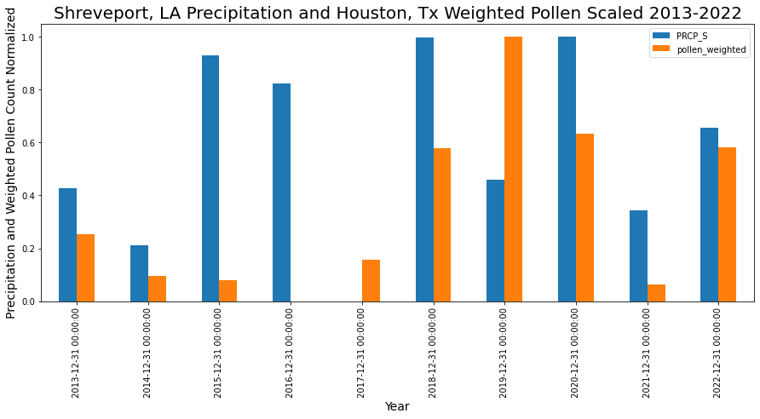
Appendix

